Slide 1
AQA Geography GCSE
at SCGSG
Discover the world you live in!

Slide 2
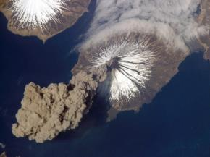
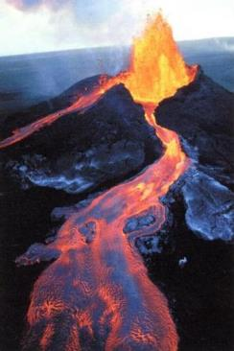
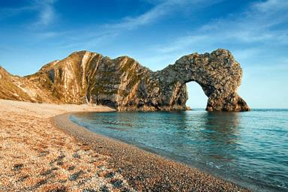
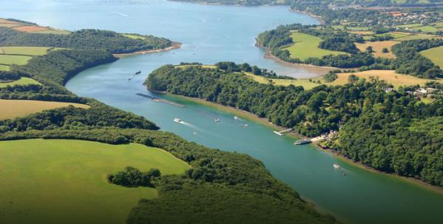
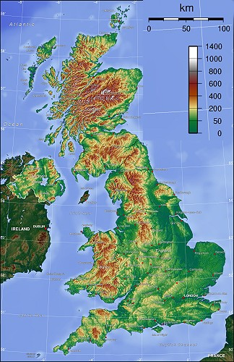
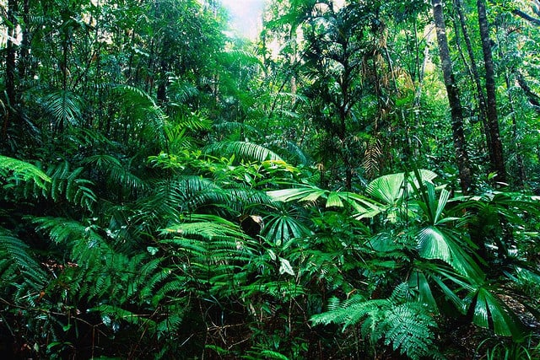
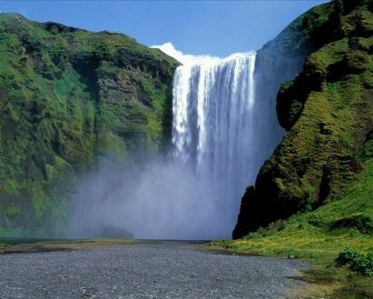
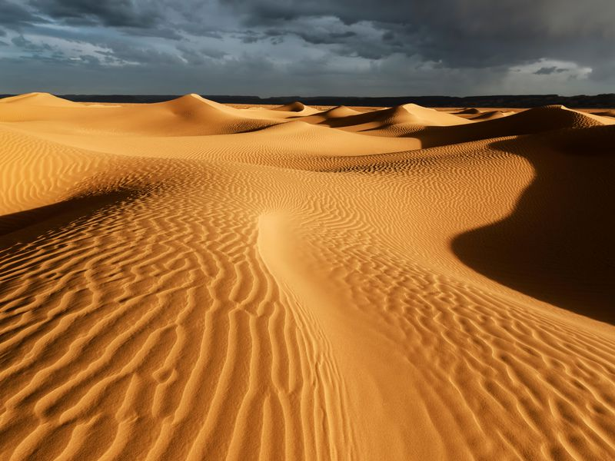
GCSE Geography at SCGSG
Paper 1: Living with the physical environment
Natural hazards
Coastal landscapes
River landscapes
UK physical landscapes
The living world

Slide 3
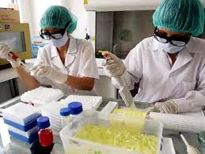
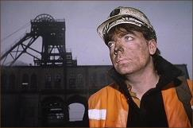
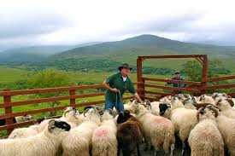
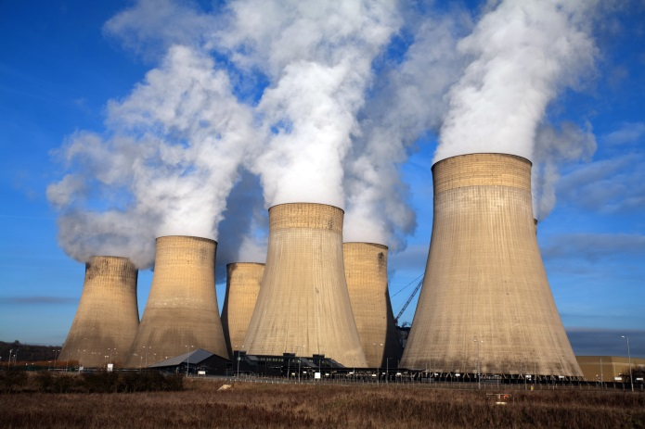
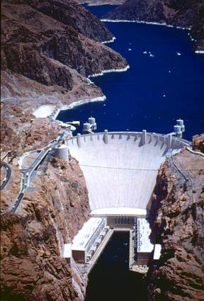
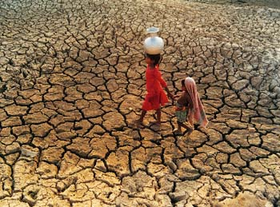
GCSE Geography at SCGSG
Paper 2: Challenges in the human environment
Urban issues and challenges
The changing economic world
Water as a resource
Resource management

Slide 4
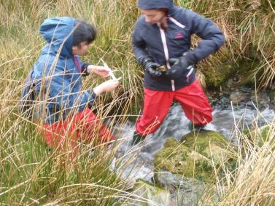
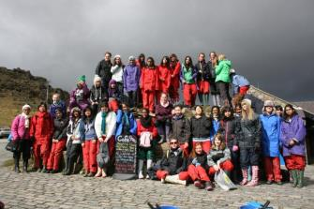
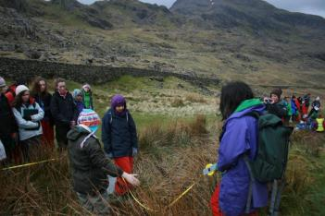
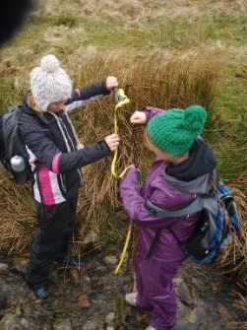
GCSE Geography at SCGSG
Paper 3: Geographical applications
Issue evaluation
Fieldwork

Slide 5
GCSE Geography at SCGSG
Paper 3: Geographical applications
Issue evaluation

Slide 6
GCSE Geography at SCGSG
Geographers have a wide range of skills that can be applied to other areas.
Here are a few examples:
Research skills, both primary - doing your own original research through fieldwork, and secondary - research using books and journals.
Statistical skills: Learning to collect, use and understand numbers is a valuable skill which is useful in science, finance, management and much more.
Computer skills: word processing, presentation, Geographical Information Systems, data sets

Slide 7
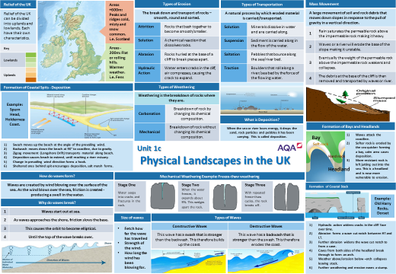
GCSE Geography at SCGSG
What support is available?

Slide 8
GCSE Geography at SCGSG
How will I be examined?
Paper 1: Living with the physical environment
Written exam: 1 hour 30 minutes
35% of GCSE
Paper 2: Challenges in the human environment
Written exam: 1 hour 30 minutes
35% of GCSE
Paper 3: Geographical applications
Written exam: 1 hour 15 minutes
30% of GCSE

Slide 9
GCSE Geography at SCGSG
Geography inspires pupils to become global citizens by exploring their own place in the world, their values and responsibilities to other people, to the environment and to the sustainability of the planet
The importance of geography, National Curriculum Programme of Study. © QCDA
Geography opens your eyes to the world around you, from the people to the landscape.
We are surrounded by geography on a daily basis, studying geography at GCSE allows us to appreciate things in much more detail.
We have such a variety of tasks from independent research, paired and group work, model making and presentations – as well as exam questions practice.
Geography links so well with my other GCSE options, so it’s great to apply my knowledge to another areas.

