Slide 1
Sutton Coldfield Grammar School for Girls
Welcome to our presentation for GCSE Spanish

Slide 2
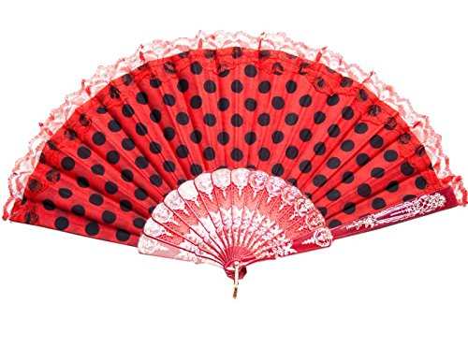
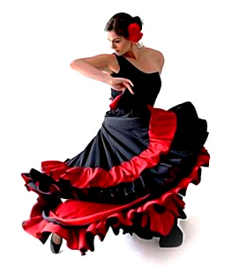
Course overview
The GCSE course offered will build on the knowledge acquired at KS3. The skills of listening, speaking, reading and writing will be further developed through the study of three themes:
Theme 1: Identity and culture
Theme 2: Local, national, international and global areas of interest
Theme 3: Current and future study and employment

Slide 3
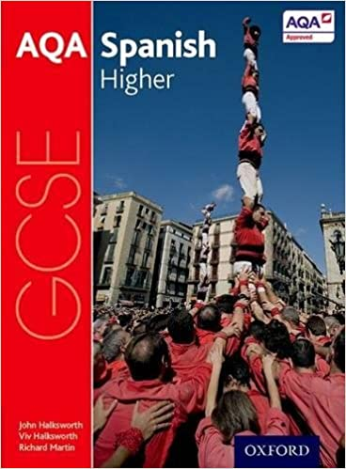
Course overview
Examples of topics within the 3 themes:
Technology in everyday life
Free-time activities
Customs and festivals
Home, town, neighbourhood and region
Life at school and college

Slide 4
Aims of the course
At the end of the course, the successful candidate will be able to:
understand spoken and written Spanish in a variety of contexts
communicate confidently, clearly and effectively through both the spoken and written word.

Slide 5
Examination
All examinations will be completed at the end of Year 11.
There will be a speaking test in the Spring Term of Year 11.
Then you will complete three examination papers – one in listening, one in reading and one in writing.

Slide 6
The 4 examination papers
Speaking: (examination conducted in school by class teachers) 12 minutes (higher tier) – 25% of final grade
The speaking test consists of a role play, discussion of a photo card and a general conversation
Listening: 45 minutes (higher Tier) – 25%
Reading: 1 hour (higher tier) - 25%
Writing: 1 hour 15 (higher tier) - 25%

Slide 7
Assessment
Assessment during the course will be by weekly homework tasks, internal assessments, peer assessment tasks and class presentations.
Students must prepare for these effectively and take the results as a serious indicator of their likely performance in the final examination.

Slide 8
Entry requirements
You should have a good understanding of the working of the language and its grammar – particularly the difference between past, present and future tenses.
Your class teacher will be able to advise on your suitability for the course at Progress Evening.

Slide 9
Personal qualities
Success in a foreign language at GCSE requires a commitment to working consistently well throughout the course.
A genuine interest in the language and culture of the country is recommended, together with a good grasp of grammar and the ability to be motivated and work well outside lessons.

Slide 10
Recommended links with other subjects
Due to the range of topics studied in modern languages, Spanish is suitable for combination with any subject in school, at GCSE and A-level.

Slide 11
Special demands on time
It is expected that students will spend about 1 and a half hours each week working on the subject outside lesson time (homework, reviewing classwork, learning vocabulary, preparing for assessment tasks).

Slide 12
Future study and careers
A GCSE qualification in a foreign language provides a good foundation for further language studies at ‘A Level’ and beyond.
It is seen as an extremely useful qualification by all employers.

Slide 13
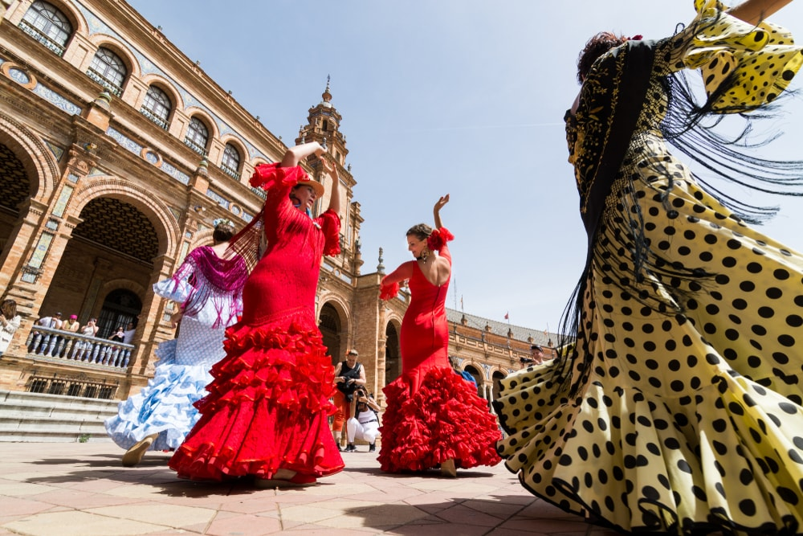
Thank you for listening and we hope you found this presentation useful! ¡Hasta luego!

