Slide 1
Do you like…?

Slide 2
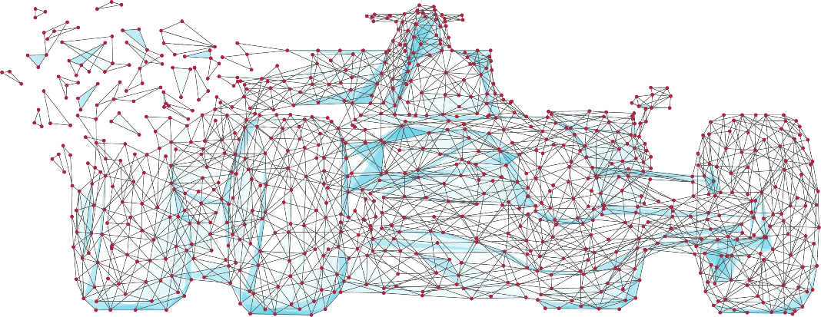
OCR GCSE (9-1) Computer Science J277
at Sutton Coldfield Grammar School for Girls
Computer Science is a modern, fascinating subject. The world depends on computers.
In this GCSE you will learn about how computers work, the networks they use and how programming can create solutions to everyday problems and future challenges.

Slide 3
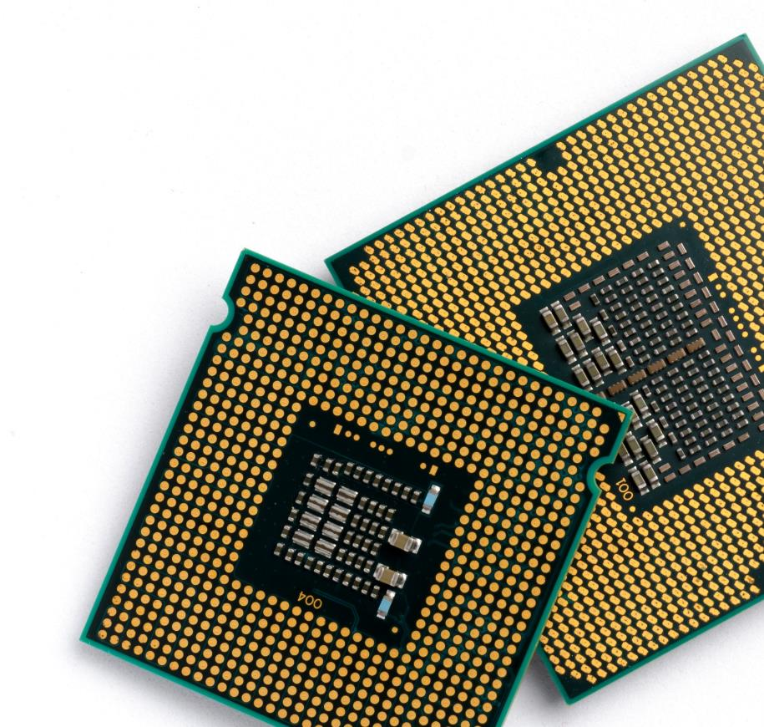
OCR GCSE (9-1) Computer Science J277
Course Overview
Component | Component Weighting
Computer systems Paper 1 – 1 hr 30mins | 50%
Computational thinking, algorithms and programming Paper 2 – 1 hr 30mins | 50%

Slide 4
OCR GCSE (9-1) Computer Science J277
Paper 1 - Computer systems (50%)
Network security and system software.
Ethical, legal, cultural and environmental concerns associated with computer science
Computer memory, storage and (CPU)
Wired and wireless networks, network topologies

Slide 5
Paper 2 - Computational thinking, algorithms and programming (50%)
Algorithms
Programming fundamentals
Producing robust programs
Boolean logic
Programming language and Integrated Development Environments.

Slide 6
Develop Programming skills
As part of the course:
You will learn to program.
Solve complex problems
Think logically
Learn through exploration

Slide 7
Why
Computer
Science?

Slide 8
Computer Science is a great subject ...
... but combined with other subjects it can open up a whole world of opportunities.

Slide 9
Why Computer Science?
Drones
Drones are already used for film making, search & rescue and surveying
In the future, deliveries to your house could be made by drone
They will need programmers to tell them where and when to go each day
Would you like to be a part of this future?

Slide 10
Why Computer Science?
Game-changing E-commerce
Shopping has been transformed since the web was invented
Online shopping was worth £1 trillion in 2014
It is predicted to be worth £3.7 trillion by 2021
Want to know how it works?

Slide 11
Why Computer Science?
Entrepreneurs & start-ups
It took just three people to create Snapchat
Bobby Murphy was the programmer who coded the app
Within four years the software was sending six billion videos per day
Most entrepreneurs can’t imagine having made it without a knowledge of IT and Computer Science

Slide 12
Why Computer Science?
A strong games industry
The UK is well known for its games development
The following were all made in the UK:
Grand Theft Auto (Edinburgh)
Elite Dangerous (Cambridge)
Candy Crush (London)
Batman: Arkham (London)
Sonic Forces (Leamington Spa)
Burnout Paradise (Guildford)

Slide 13
Why Computer Science?
Robotics & Artificial intelligence
We are finding more and more uses for robots
Robotic vacuums in the home
Car assembly
Clearing mines in a war zone
To make a robot you need to have a good understanding of how computers work and how to program them

Slide 14
Big companies in the UK
Major international companies are present in the UK and looking for bright new talent
Google
Microsoft
Apple
Samsung
Facebook

Slide 15
Careers in…

Slide 16
How can I be successful in computer science?
Have interest in technology
Be prepared to work hard

Slide 17
Mr Opong
Head of Computer Science
nop@suttcold.bham.sch.uk

