Slide 1
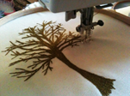
GCSE TEXTILE DESIGN AQA 8204
Textile design is defined as the creation of designs and products for woven, knitted, stitched, printed or decorative textiles that might have a functional or non-functional purpose.

Slide 2
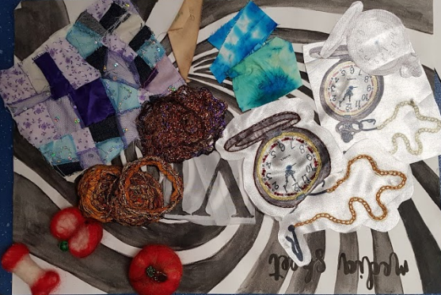
We are a Textile course that focuses on a skills based curriculum
Within the context of textile design, you will be taught to use textile design techniques and processes, appropriate to students’ personal intentions, for example:
Wet felting
Needle sculpting
Free machine Embroidery
Creative stitching
Applique Art
Quilting
Slash and burn
Printing and colour applications
Garment Construction

Slide 3
GCSE TEXTILE DESIGN AQA 8204 Course Structure
Component 1 - Portfolio
Component 2: Externally set assignment
What's assessed
A portfolio that in total shows explicit coverage of the four assessment objectives. It must include a sustained project evidencing the journey from initial engagement to the realisation of intentions and a selection of further work undertaken during the student’s course of study.
How it's assessed
No time limit
96 marks
60% of GCSE
Non-exam assessment (NEA) set and marked by the school/college and moderated by AQA during a visit. Moderation will normally take place in June.
What's assessed
Students respond to their chosen starting point from an externally set assignment paper relating to their subject title, evidencing coverage of all four assessment objectives.
How it's assessed
Preparatory period followed by 10 hours of supervised time
96 marks
40% of GCSE
Non-exam assessment (NEA) set by AQA; marked by the school/college and moderated by AQA during a visit. Moderation will normally take place in June.

Slide 4
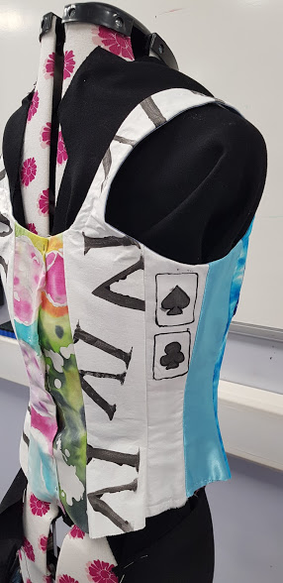
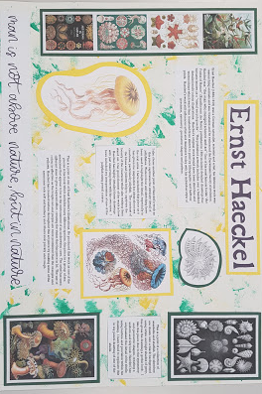
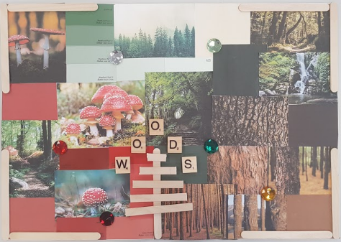
Course Structure
We explore 2 broad themes to improve your skills and techniques in a range of media.
The Themes are:
Natural Forms -The Beach and The Woods
Colour and construction - Fairy tales

Slide 5
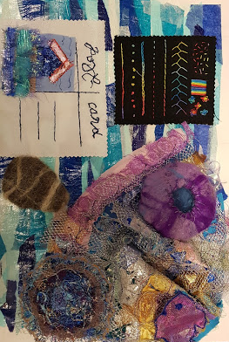
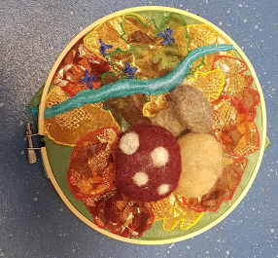
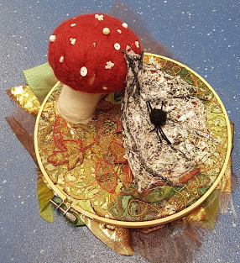
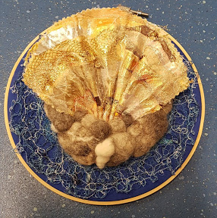
Natural Forms

Slide 6
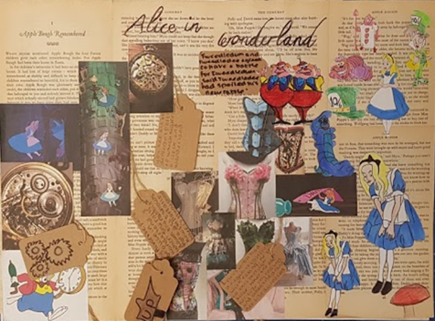
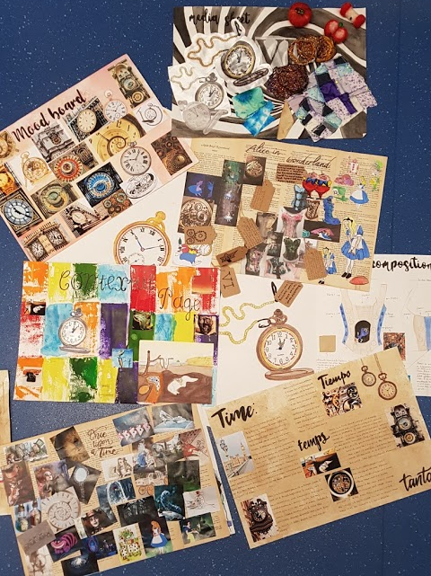
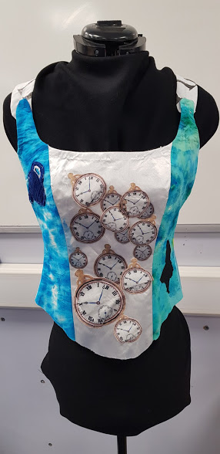
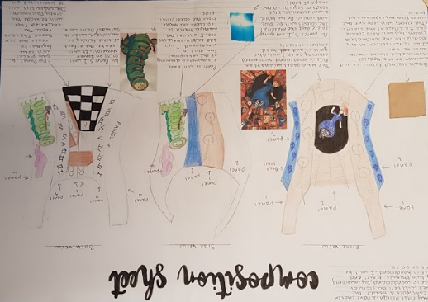
Fairy Tales

Slide 7
Careers in Textiles
Jobs directly related to your course include:
Clothing/textile technologist
Colour technologist
Interior and spatial designer
Fashion designer
Textile designer
Fabric designer
Jobs where your Course would be useful include:
Conservator
Further education teacher
Graphic designer
Higher education lecturer
Printmaker
Product designer
Retail buyer
Secondary school teacher
Stylist
Visual merchandiser

Slide 8
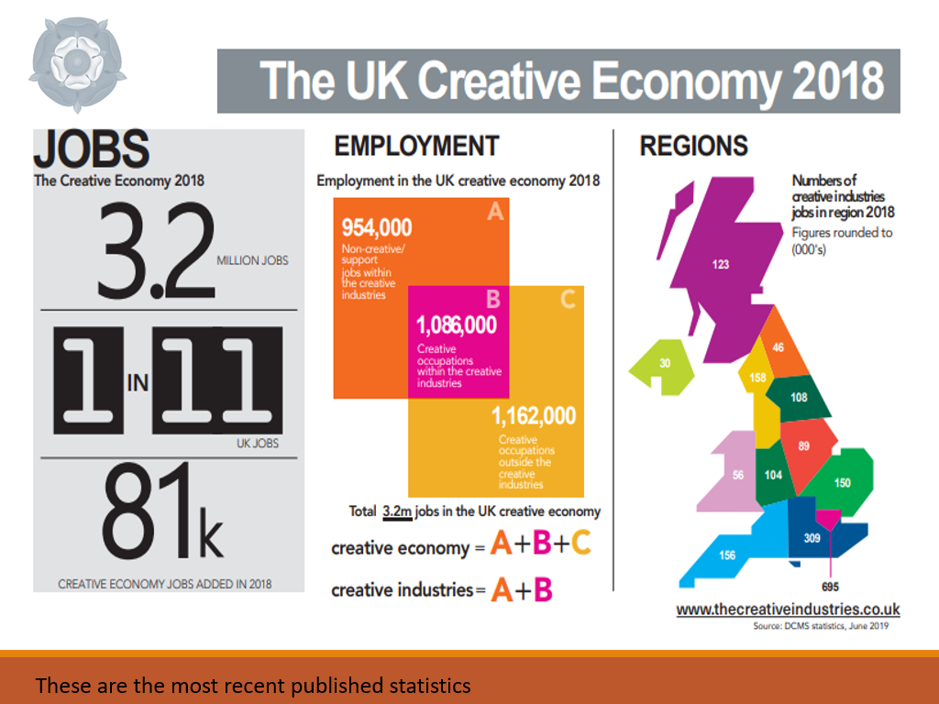
These are the most recent published statistics

Slide 9
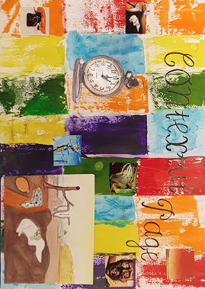
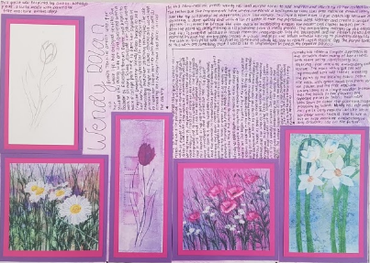
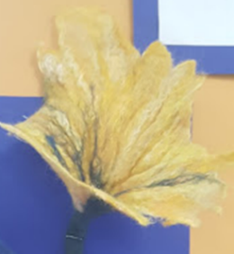
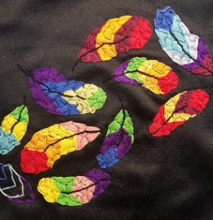
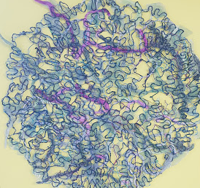
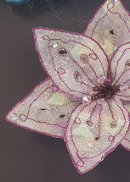
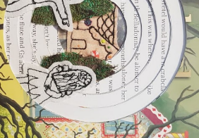
Examples of Student work

