Slide 1
GCSE Art
AQA Fine Art 8202
Head of Department: Mr M Davis – mda@suttcold.bham.sch.uk

Slide 2
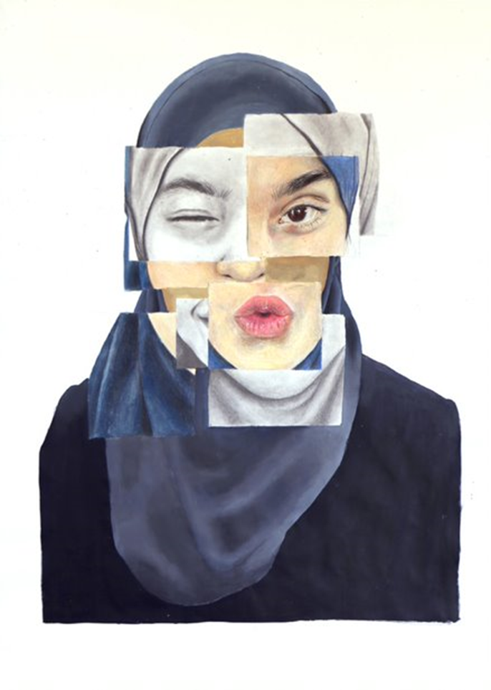
We are a Fine Art based course meaning that we specialise in:
Drawing
Painting
Mixed Media
Photography
Critical Contextual Studies
The course is 60% NEA and 40% Examination
The Content is guided but students can explore their own interests within the set projects

Slide 3
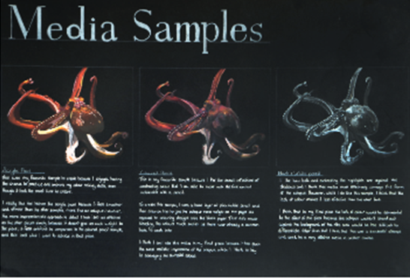
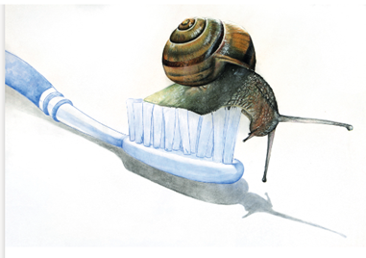
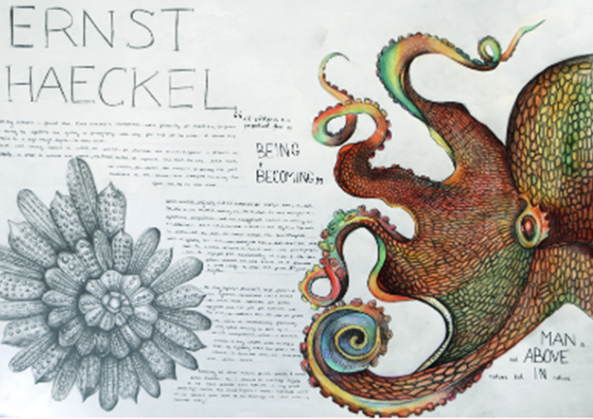
Course Structure
We explore 3 broad themes to improve your skills in a range of media.
The Themes are:
Natural Forms
Still Life
Portraiture

Slide 4
After Learning the skills in Year 10 you will then explore ideas, media and composition to create your own pieces of work

Slide 5
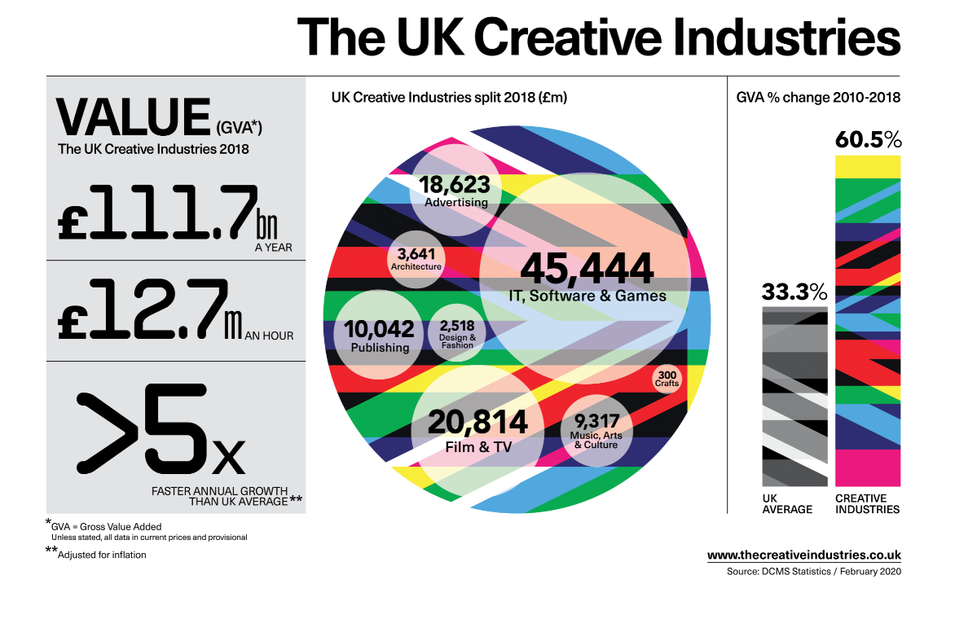
These are the most recent published statistics

Slide 6
These are the most recent published statistics

Slide 7
Student Destinations After A Level
Architecture Graphic Design Medicine Illustration Civil and Architectural Engineering Mathematics Fashion Buying and Marketing Television Production Design Philosophy and Theology Theatre Production Design Fine Art

Slide 8
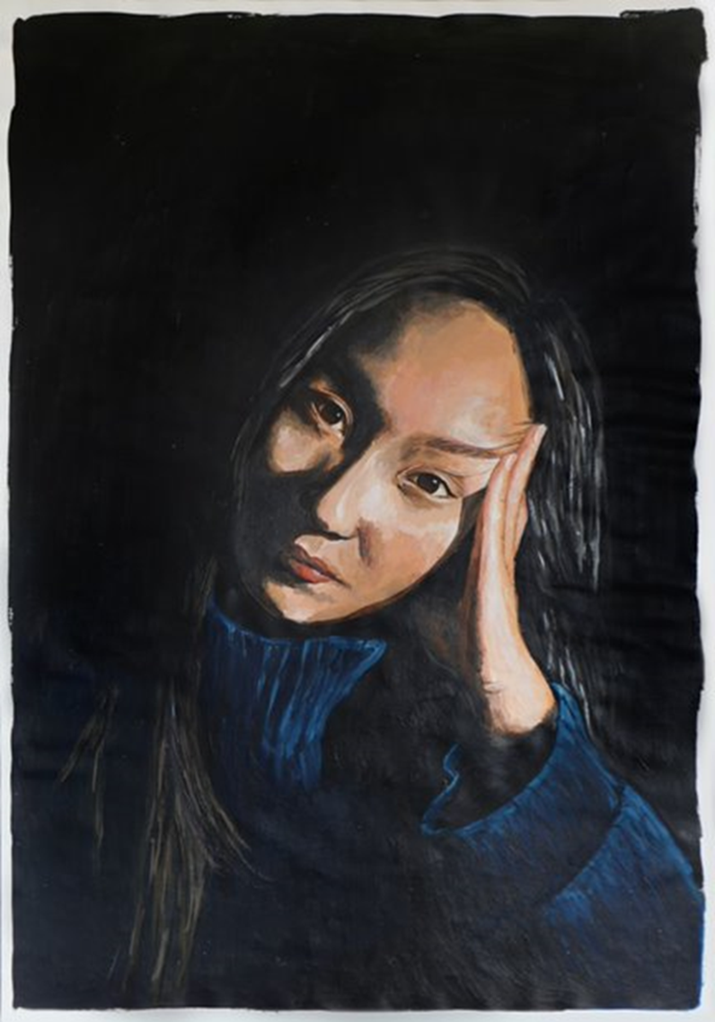
Please look at our online Galleries on the school website for more examples of Student work.

