Slide 1
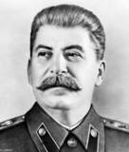
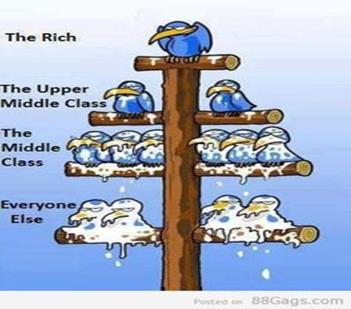

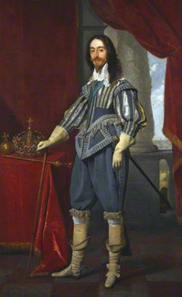
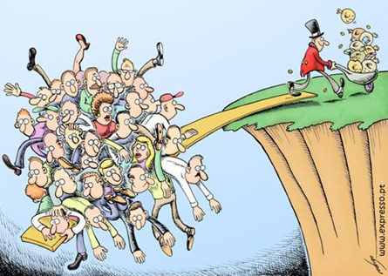
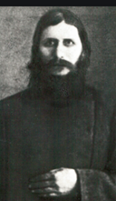
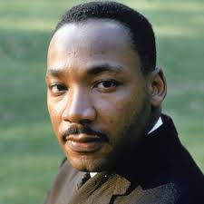
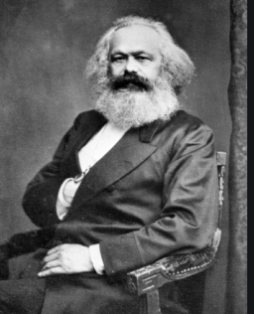
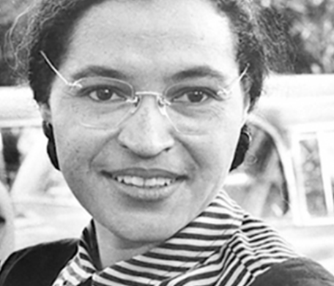

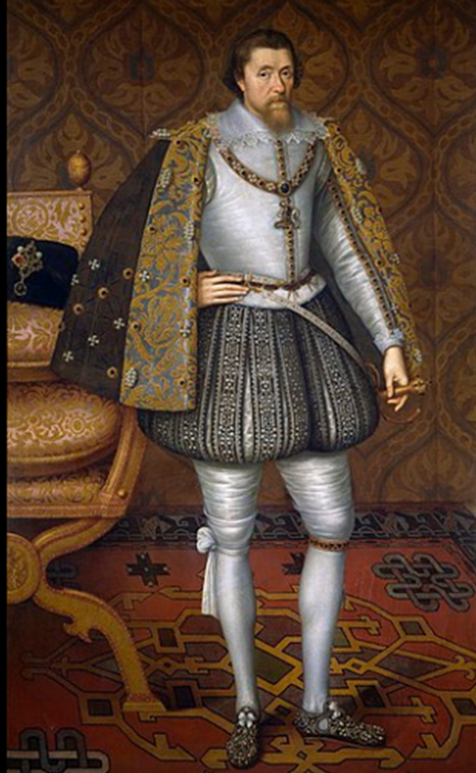
OCR A LEVEL HISTORY
fhe@suttcold.bham.sch.uk
Mrs F Heeks (US History)

Slide 2
An introduction to Civil Rights in the USA 1865-1992
Task 1
If you haven’t already completed the transition work set by the History Dept you need to do so before moving on. See below for details of the USA work.
Make sure you login to the Historical Association website
www.history.org.uk
Username 30215
Password SuttCold73
This site has amazing resources, latest thinking, revision techniques, podcasts, past papers etc
Look up and read/listen to the following in particular
Click on the Student area icon, then go to A level topic guides
In the US History section listen to the podcast on the American Civil War
Watch the films ‘An introduction to the American Civil Rights Movement’ and the film about ‘Key Individuals in the African Civil Rights Movement’
Find the following documentary
Lucy Worsley’s ‘Biggest Fibs in American History’
Watch episode 2 about Abraham Lincoln and the American Civil War as it is particularly relevant to your History A level and will get you thinking about interpretations and why they change over time.
www.dailymotion.com/video/x73cnst

Slide 3
Unit outline
Unit 3 – H505/Y319 – Thematic, Change and |Continuity
Civil Rights in the USA 1865-1992
You will take a written exam lasting two hours and thirty minutes. You will answer two 25 mark essay questions out of a choice of three and one 30 mark interpretation question.
This unit is worth 40% of your A Level.
Unit Y319: Civil Rights in the USA 1865–1992
This theme focuses on the struggle of citizens in the United States to gain equality before the law. Learners should understand the factors which encouraged and discouraged change during this period. The strands identified below are not to be studied in isolation to each other.
Learners are not expected to demonstrate a detailed understanding of the specification content, except for the named in-depth studies, but are expected to know the main developments and turning points relevant to the theme.
Thematic Study: Civil Rights in the USA 1865–1992
Learners should have studied the following:
African Americans
Their position in 1865, Reconstruction, white reaction and discrimination; the role of African Americans in gaining civil rights (e.g. Booker T Washington, Dubois, Martin Luther King, the Black Panthers); the roles of Federal (Presidents, Congress and Supreme Court) and State governments in the struggle; the role of anti- and pro-civil rights groups; the Civil Rights Movement to 1992.
Trade Union and Labour Rights
Union and Labour rights in 1865; the impact of New Immigration and industrialisation on union development; the role of Federal governments in supporting and opposing union and labour rights; the impact of the World Wars on union and labour rights; the significance of the 1960s; Chavez and the UFW; significance of the Reagan era.
Native American Indians
Their position in 1865; the impact of the Plains Wars (1854–1877); the impact of the Dawes Act 1887, of the acquisition of US citizenship 1924, of the New Deal, of the American Indian Movement in the 1960s and 1970s; Native Americans and the Supreme Court; Native American pressure groups.
Women
Their position in 1865; the impact on women’s rights of the campaign for prohibition; the campaign for women’s suffrage; the New Deal; the World Wars; the rise of feminism and its opponents, Roe v Wade 1973, the campaign for the Equal Rights Amendment; changing economic and employment opportunities.

Slide 4
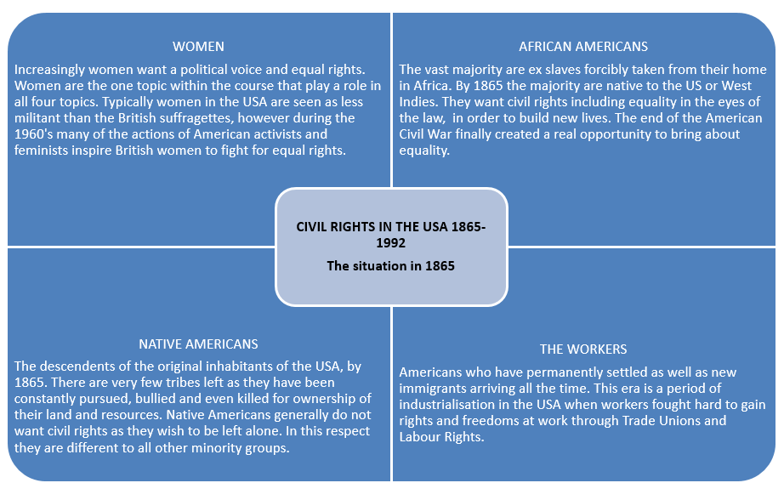
In 1865, what position do our four groups find themselves in?

Slide 5
Native Americans – a brief background
Native Americans are the indigenous people of America. They lived a tribal and often nomadic lifestyle all over the Americas before the arrival of the white settlers. Although there were a few success stories on the whole the white settlers believed the Native Americans should bend to their will and adopt their lifestyle – Christianity, building a home, western style dress, take up farming or trade. Some NA’s did exactly this but the majority accepted that although white settlers where here to stay they were going to try to avoid them as much as possible or even get rid of them. By 1865 the relationship between whites and NA’s was very strained with the governments attitude being one of attempting to move NA’s out of the way. Those NA’s who hadn’t already died found themselves moved to reservations. Large areas of land where they could live separately from the white man. However these reservations were usually ill equipped and poorly resourced making life very difficult and very humiliating for the remaining Native American tribes.

Slide 6
Task 2
We will begin the Civil Rights unit by studying the fate of Native Americans at the hands of white Americans
Use the attached sources to answer the following questions
The Battle of Little Bighorn 1876
Read the sources carefully and use the evidence they contain to answer the following questions
1. Who was fighting who at this battle?
2. Why were the two sides fighting?
3. What evidence is there that the cavalry were poorly prepared?
4. What evidence is there that the Native Americans were well prepared for battle?
5. Can you use the sources to work out how the battle played out and why the NA’s won in the end?
6. Use the sources to explain why the Battle of Little Big Horn helped embed the intolerance of white Americans towards Native Americans.
7. Some white Americans were willing to accept some responsibility for the actions of the NA’s at the battle, can you think why they might have felt like this when considering the actions and attitude of Custer?
Keep this work safe as we will slot it into your folder once we get going in September

