Slide 1
Communication:
What makes a great communicator?

Slide 2
Warm Up
You have 1 minute to sell your pen to someone in your household or over the phone to a friend.
Then swap roles and feedback to each other at the end.

Slide 3
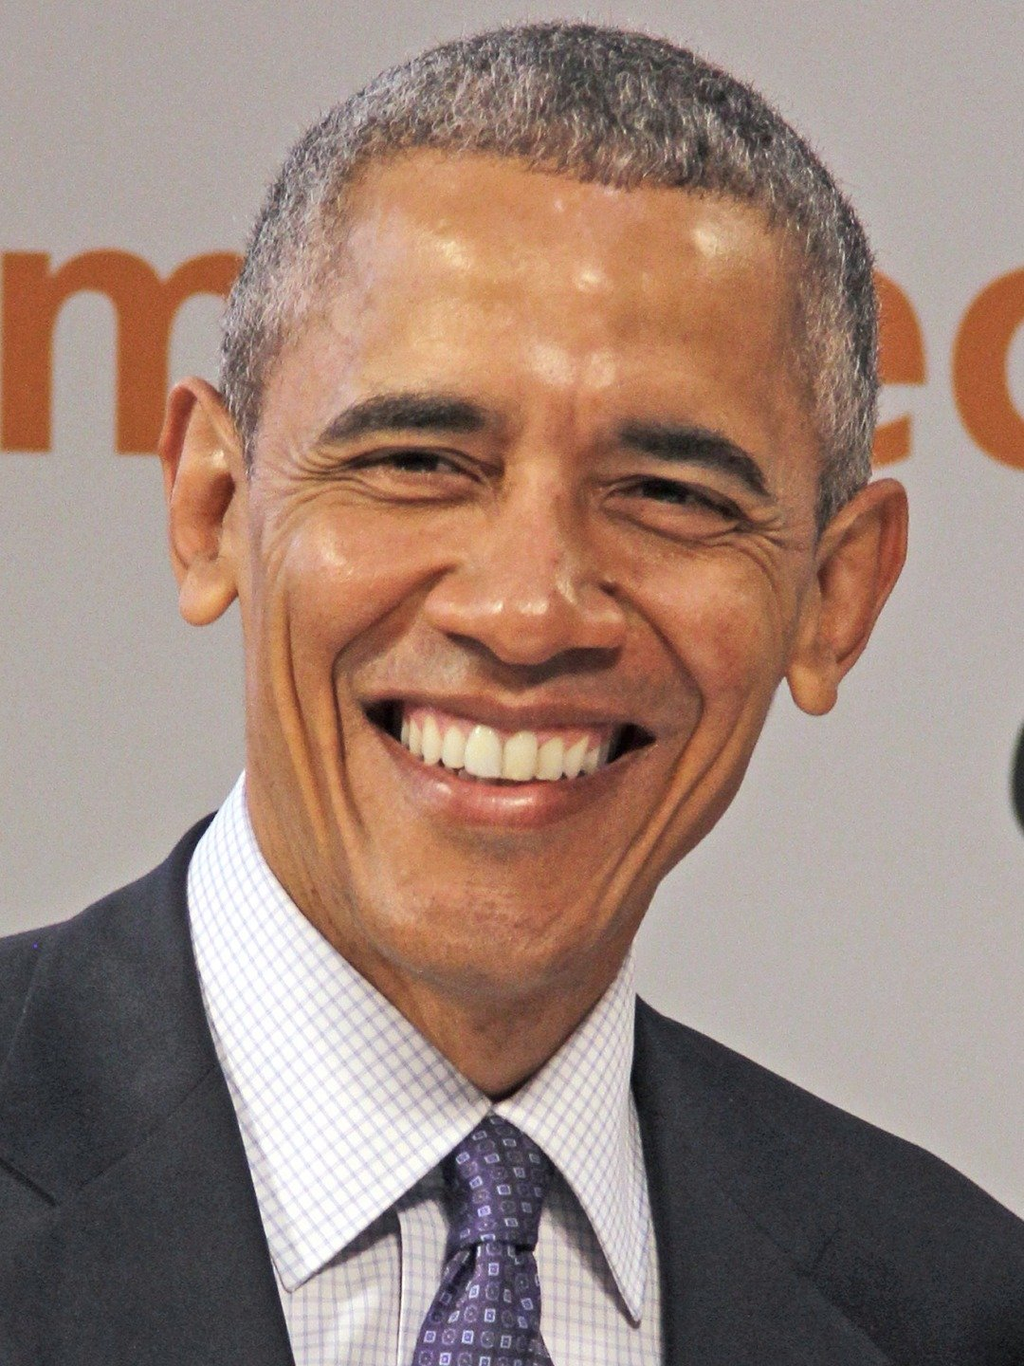
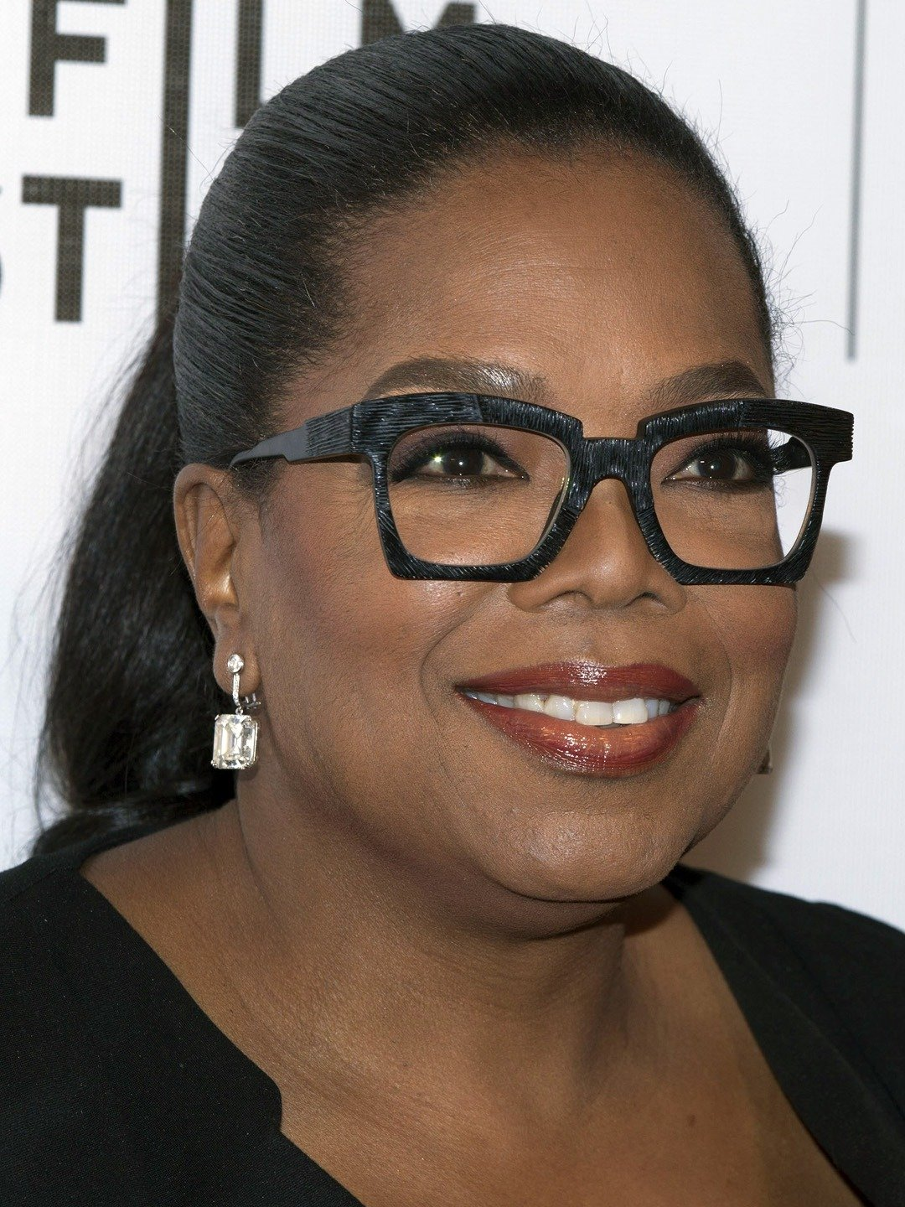
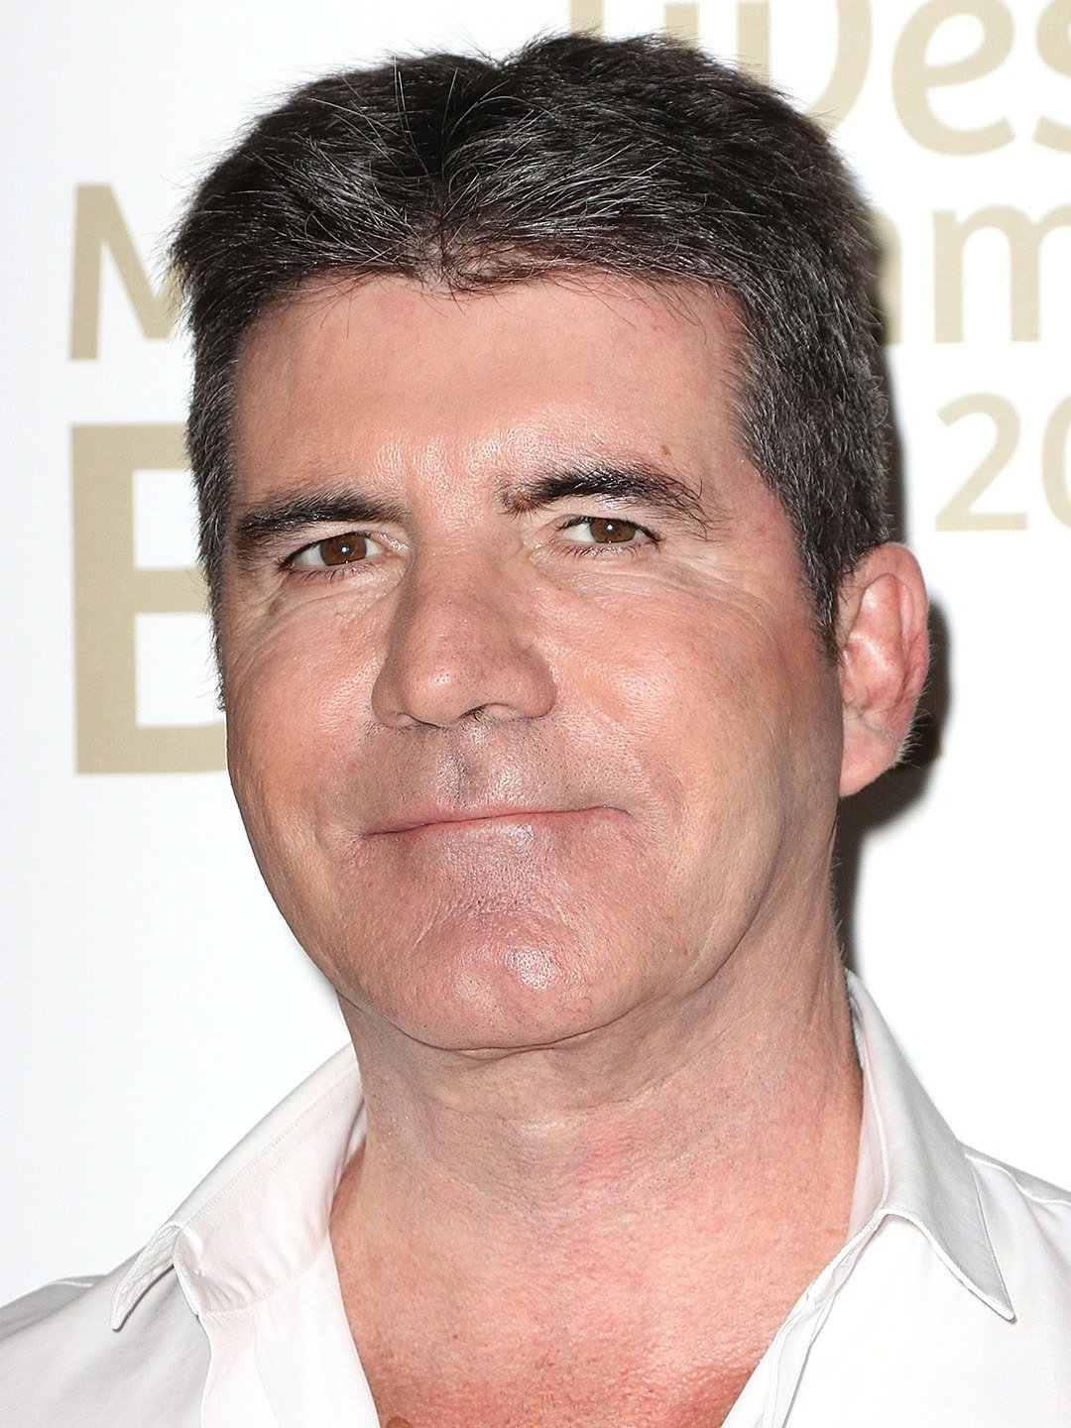
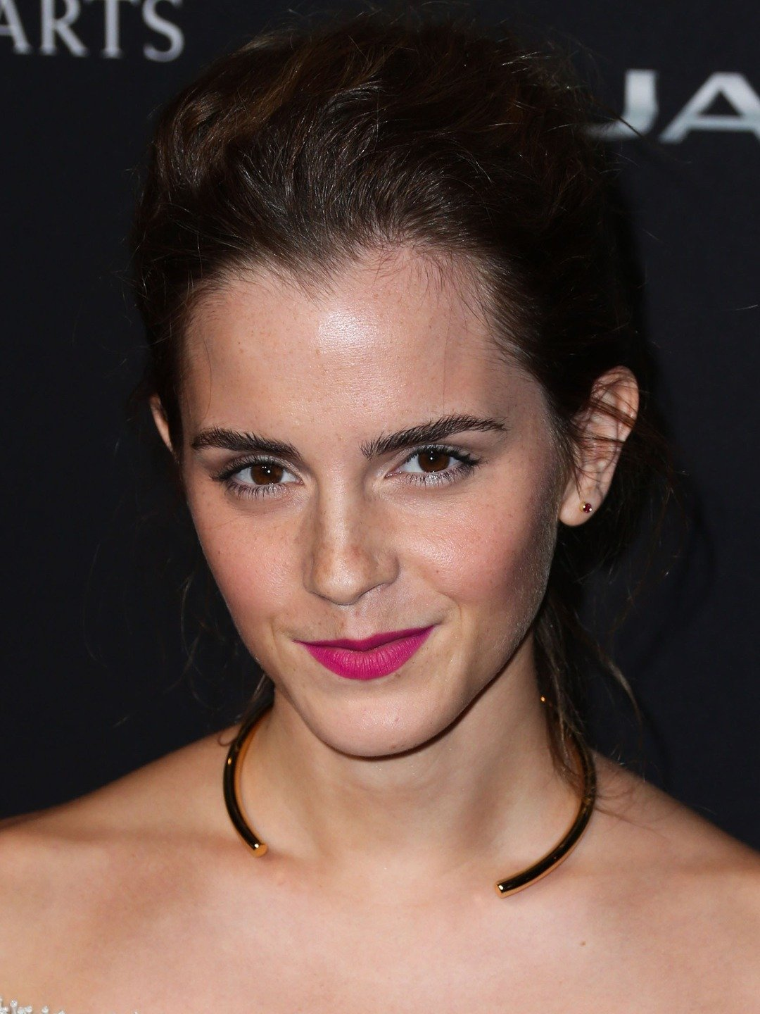
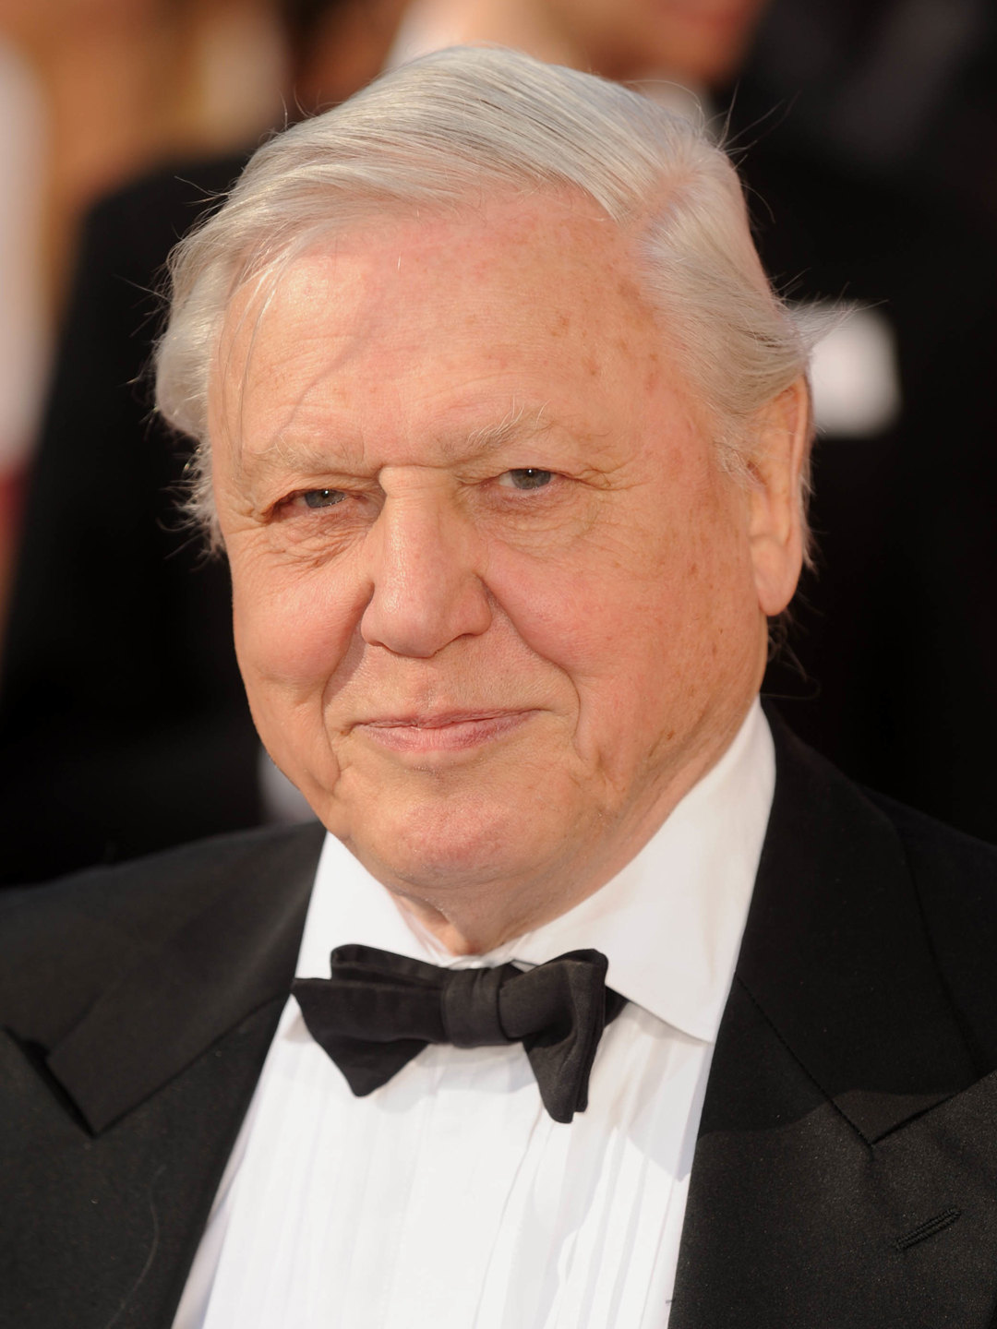
Who do you think is a great communicator? Why?
Spend 2-3 minutes thinking about who you think is a good communicator and why.
It could be a politician, actor, or other famous person. It might be a friend, family member or even a teacher!

Slide 4
What makes a great communicator?
Watch this TED talk about effective communication. Make notes about the key concepts, in particular:
The 7 deadly sins of talking
The HAIL Approach
Top tips for communication
Following the video, discuss your findings with your partner.
Click here to watch a TED talk on How to Speak so People Want to Listen by Julian Treasure
(10 mins)

Slide 5
What makes a strong communicator?
Builds strong relationships
Communicates confidently and effectively with individuals of all ages and positions
Makes a strong personal impression on others
Adapts communication style to suit audience
Uses appropriate tone of voice and speed of delivery for audience
Communicates information to groups in an exciting and interesting way

Slide 6
Now try it again…
You have 1 minute to sell your pen to the person you tried it on earlier.
Then swap roles and feedback to each other at the end. Was your sales pitch better the second time around?

Slide 7
Unifrog Communication Activity
Go to the Competencies tool and add an example for Independence/Communication from when you have effectively demonstrated skills in this area.
EC: Write a 50 word post about a time you needed to persuade someone of the benefits of an idea you had- You could record this in Competencies as Resilience.
Make sure you add as much detail as possible. Structure your answer:
Situation
Task
Action
Result

