Slide 1
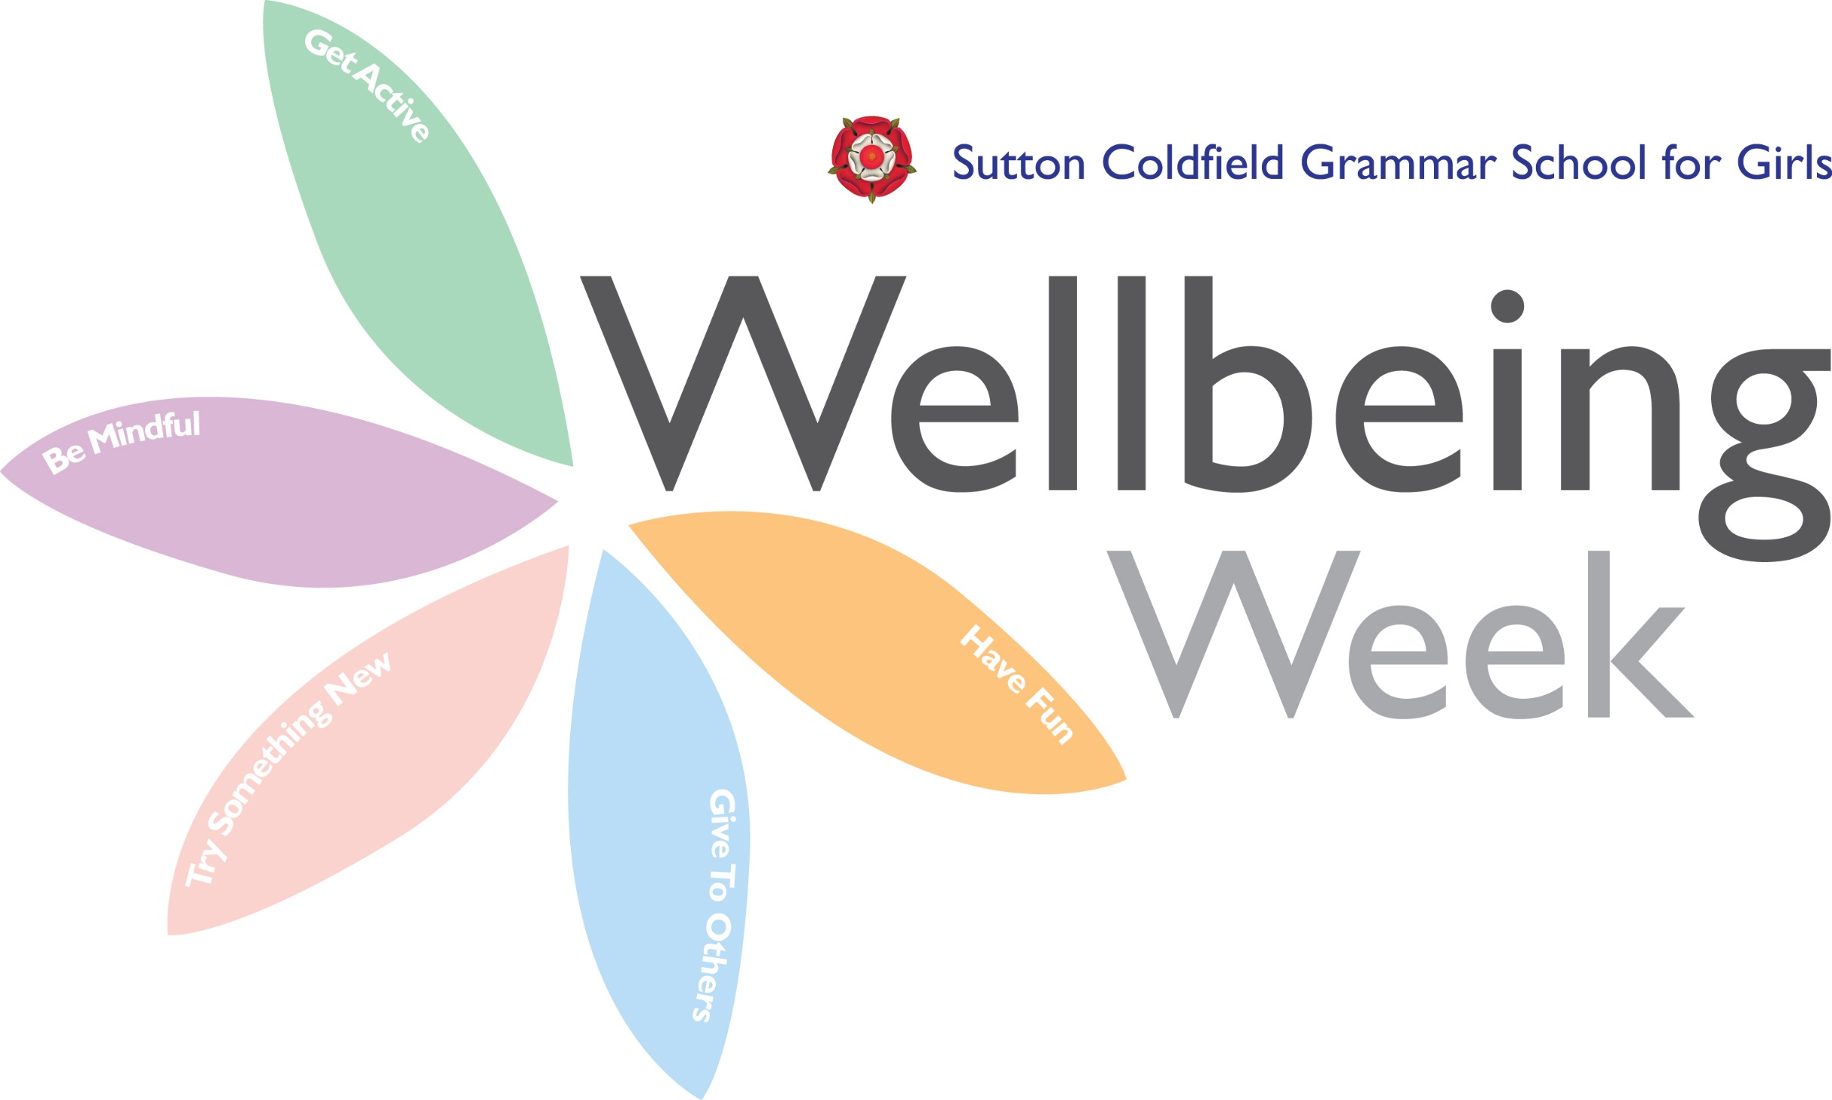
STOMP

Slide 2
Music benefits
Relaxation
Manual dexterity
Focal point
Self-esteem
Fun!

Slide 3
What can you create at home or with friends over the phone?

