Slide 1
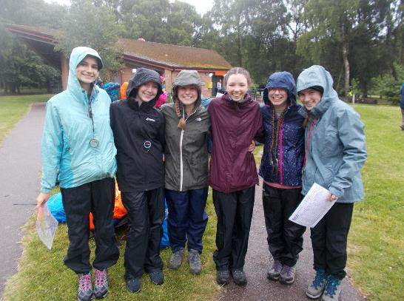

DofE presentation evening
DofE Information Evening
Tuesday 7th March 2023
Notes:
Presenter: Please customise this slide with the contact details of your DofE leader/administrator.
​Outline the next steps for parents:​
​Check the school / organisation’s process for signing up to DofE.​
​Parents / carers will need to complete and return some paperwork and payment.​
​Start a conversation with your young person about what activities they might choose for their DofE.​

Slide 2
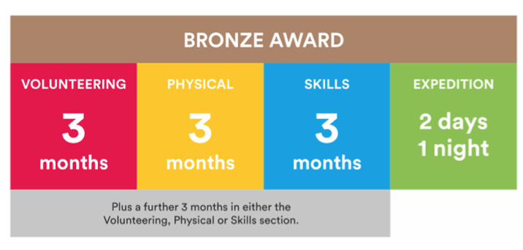
What is involved?
Notes:
There are three levels of DofE Award – Bronze, Silver and Gold. To achieve their Award, your child will need to complete four sections – Volunteering, Physical, Skills and Expedition (add residential for Gold). ​
​The length of time they will need to devote to each section will vary, depending on whether they are at Bronze, Silver or Gold level.​
Choosing which activities to do for each section may seem daunting for your young people. But it’s important to remember that most activities can count.
Many young people will already take part in activities which can be counted towards their DofE Award, and there are a huge number of activities on offer for young people who are keen to try something new.​
​It is important to make sure that the young people are keeping a record of the time they spend on each activity. They may need your support to find an assessor for each section.
Assessors are people who check that activities have been completed and describe the progress that has been made. An assessor should be somebody who has a good understanding of the chosen activity. It can be anyone apart from members of your family.​
​I will now describe each section of the award in more detail.​
​

Slide 3
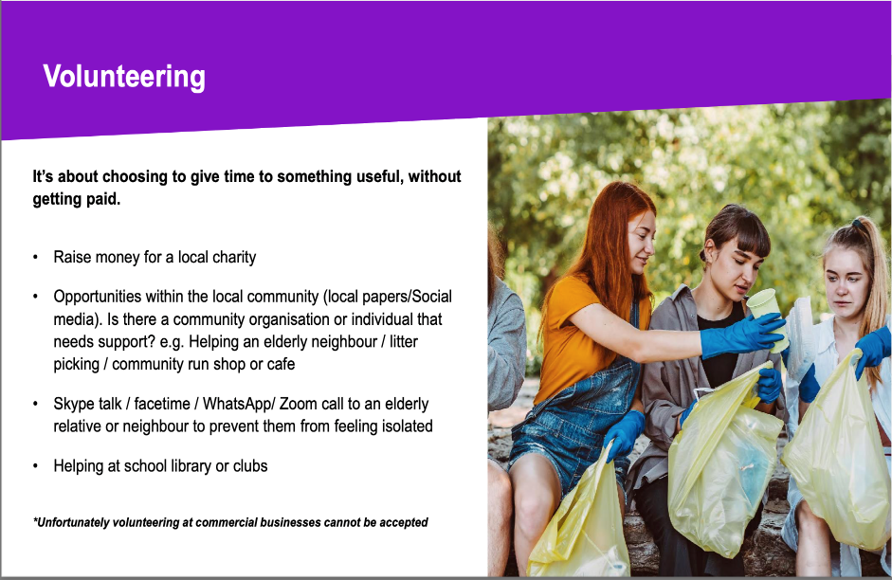

Slide 4
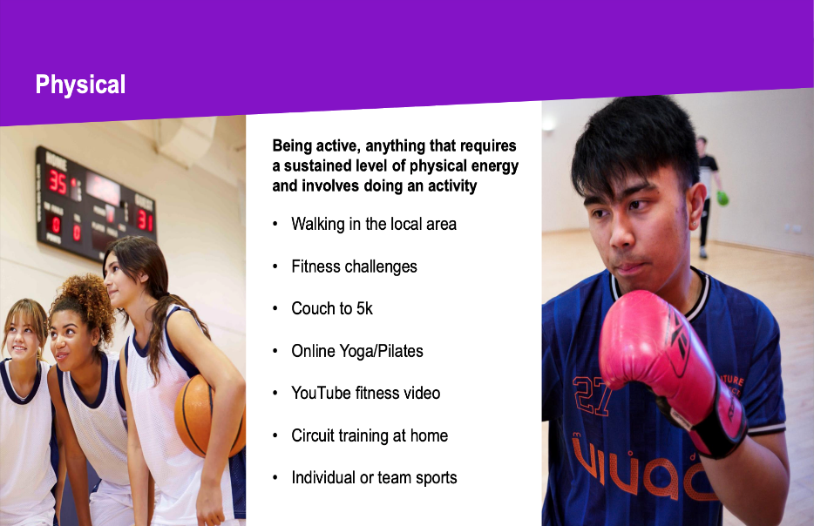

Slide 5
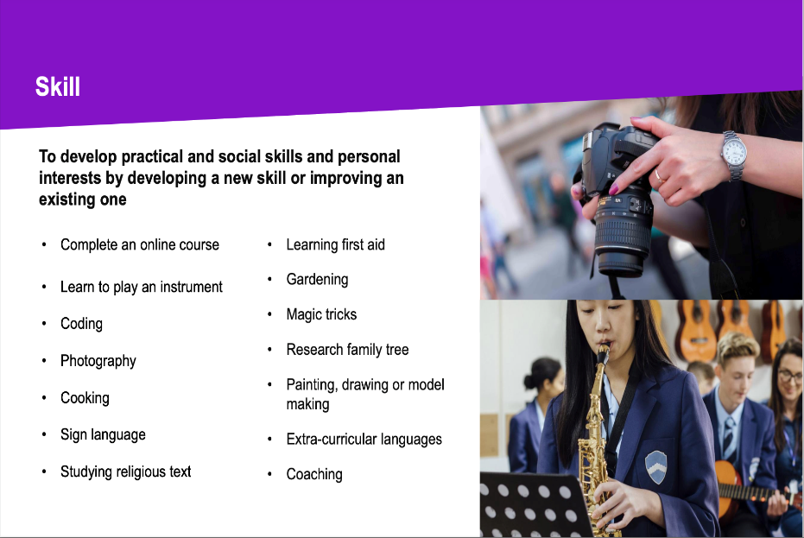

Slide 6

Deadline for submitting volunteering,
skill and physical reports is Wednesday 5th July 2023.

Slide 7
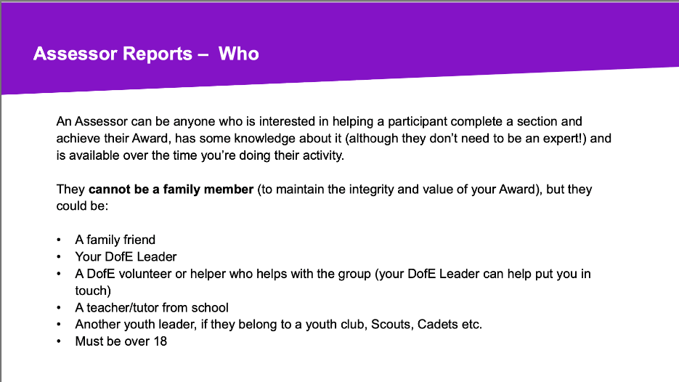

Slide 8
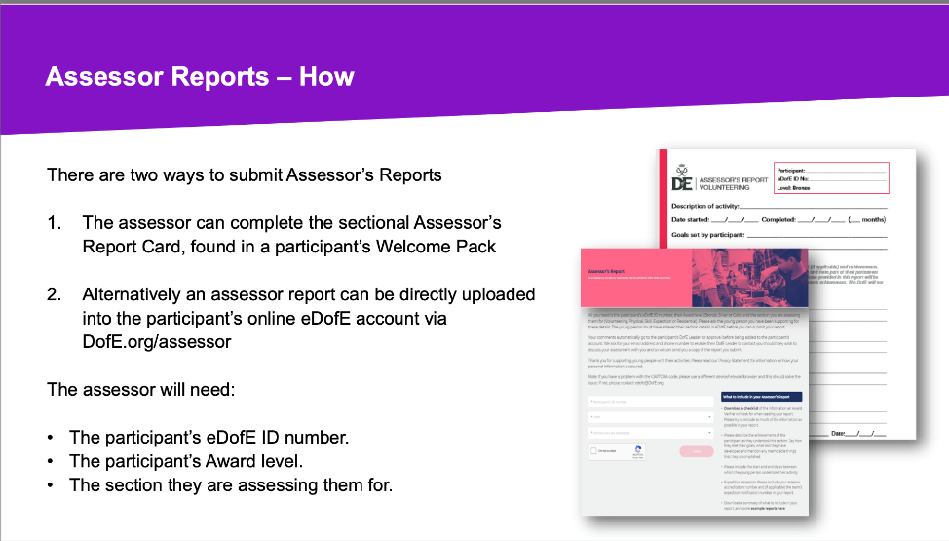

Slide 9
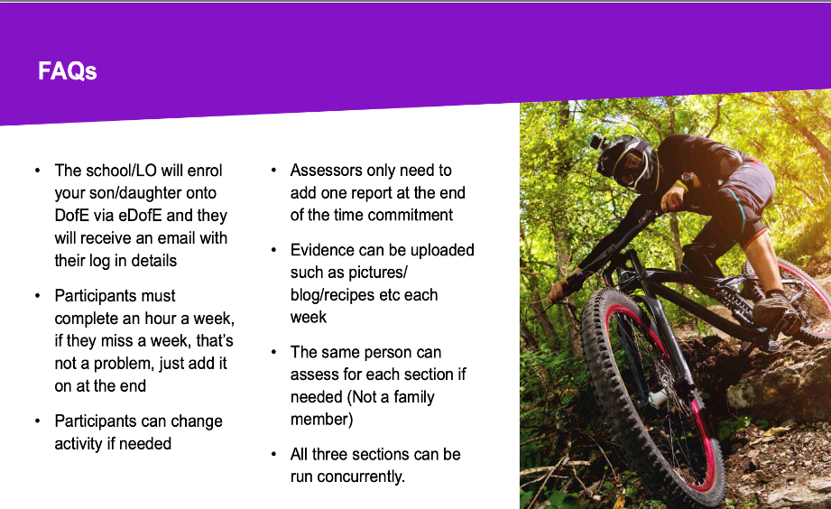

Slide 10
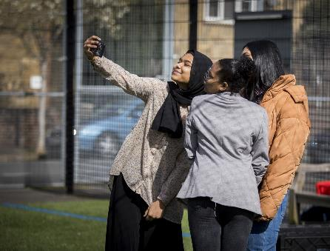
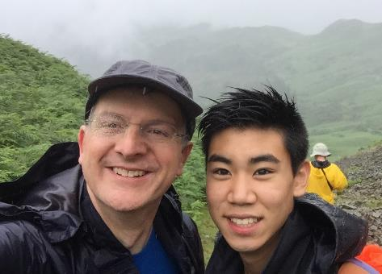
Your role
Guidance
Encouragement
Practical support
Recognising achievement
Notes:
There are several ways you can help your young person to achieve their DofE Award.​
​You should provide guidance and advice – support them with things like choosing their activities and finding assessors.
Encouragement - It can be challenging to keep the motivation going, especially over some of the longer timeframes.​
​If they need it, help keep them on track with their activities, particularly those which are being done from home.​
​Practical support - You may be required to drop off/collect from expeditions and activities, make sure they have all the right kit and also wash the kit when it comes home! ​
​Recognising achievement - We hope all organisations will recognise the amazing achievement, and it is just as important to receive that recognition from family members. ​
​

Slide 11



Slide 12
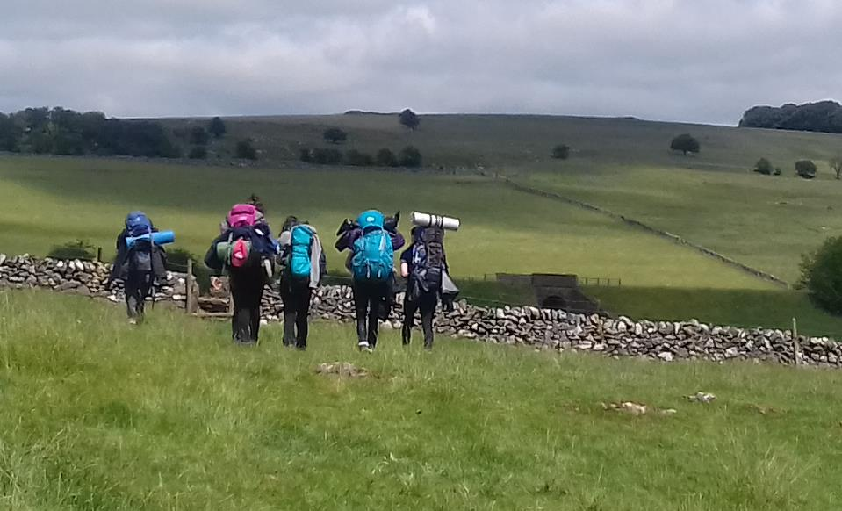
Sutton Coldfield Grammar School for Girls
Steve Wilkins
Managing Director, Karos Adventure

Slide 13
Information on karosadventure.com

Slide 14
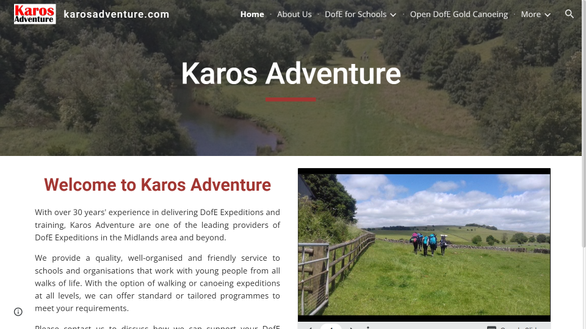
Preparing for the Expedition

Slide 15
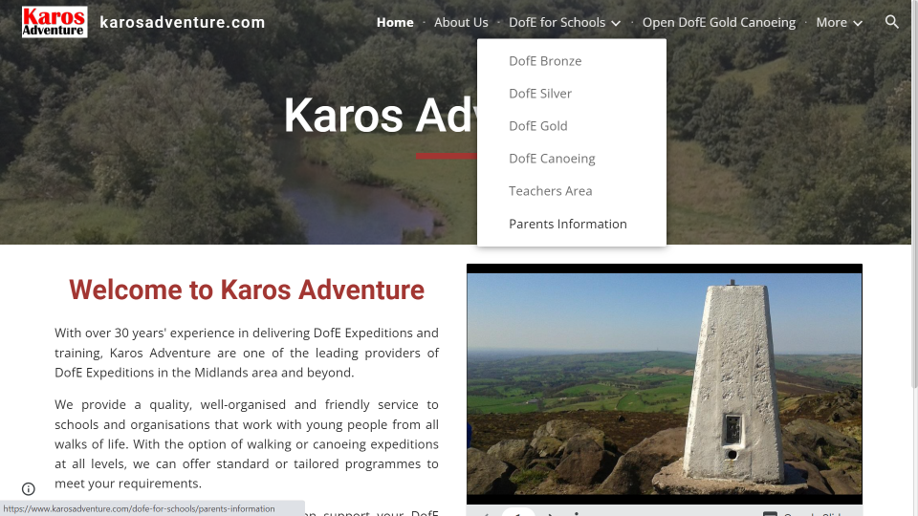
Preparing for the Expedition

Slide 16

Preparing for the Expedition

Slide 17

Preparing for the Expedition

Slide 18
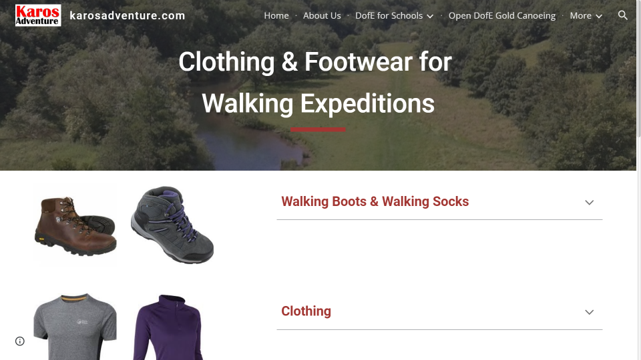
Preparing for the Expedition

Slide 19
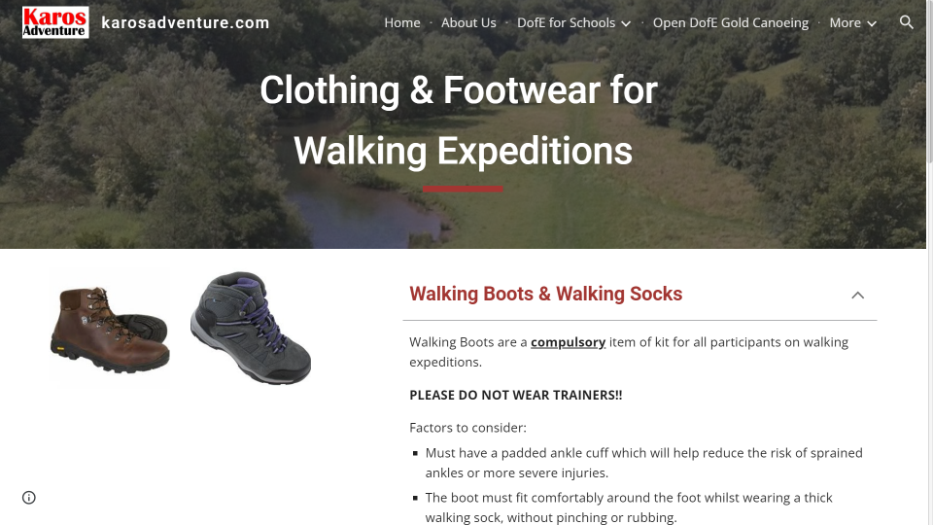
Preparing for the Expedition

Slide 20
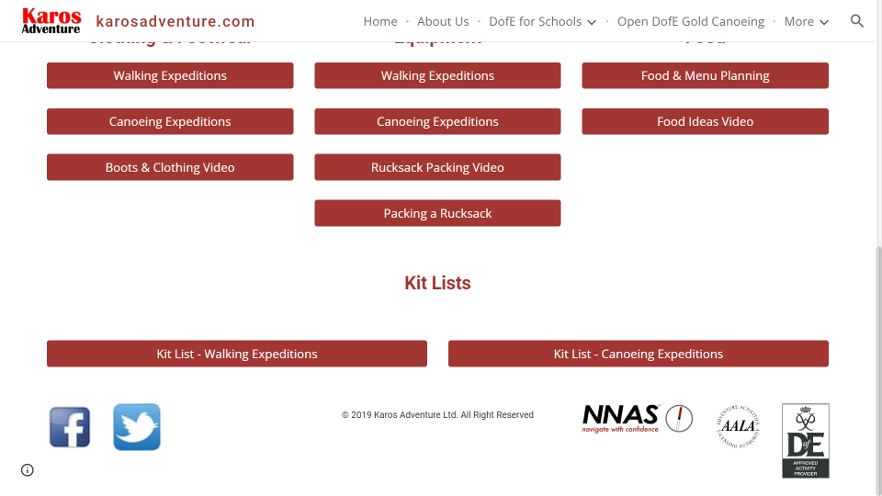
Preparing for the Expedition

Slide 21
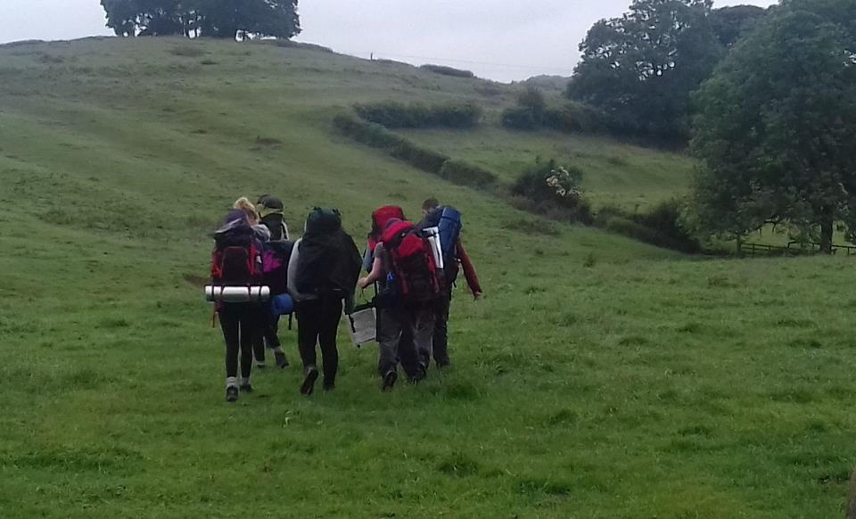
Clothing & Equipment

Slide 22
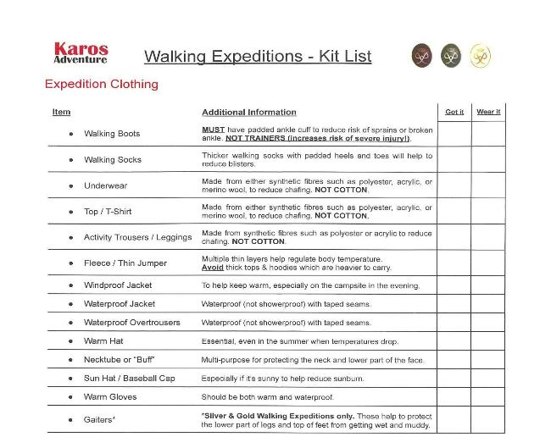
Clothing & Equipment
Kit List
Download from website
Part of Joining Instructions
Borrow kit from family, friends or other DofE participants where practical

Slide 23
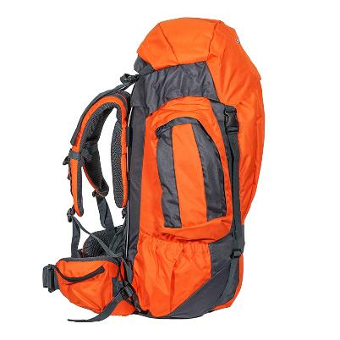
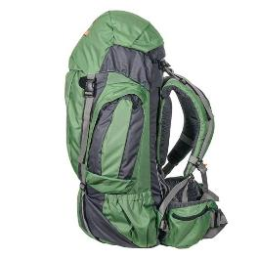
Rucksacks for Hire
Standard 65 litre rucksack or
“Slimjim” 65 litre with smaller back system.
Limited supply available.
£10.00 + VAT for programme.
Ordered via school.
Delivered to start.
Collected at finish.
Standard 65 litre
Slimjim 65 litre

Slide 24
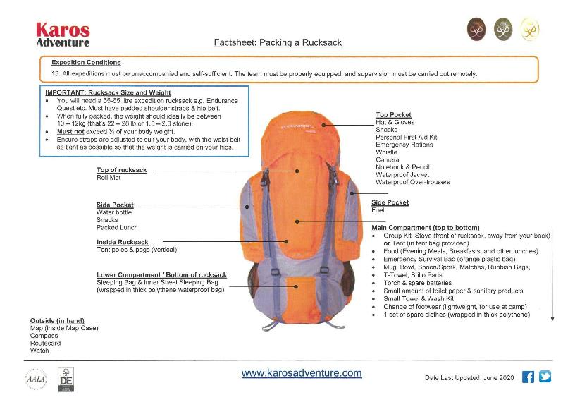
Clothing & Equipment

Slide 25
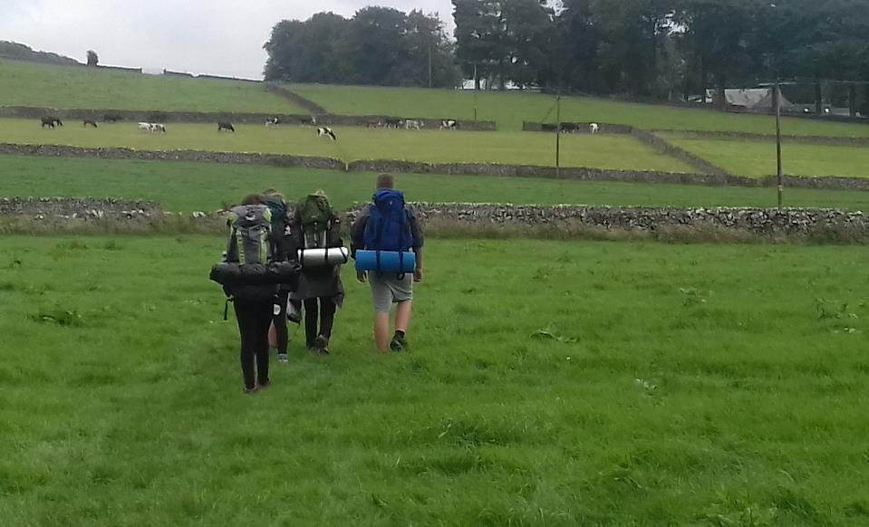
Food & Menu Planning

Slide 26
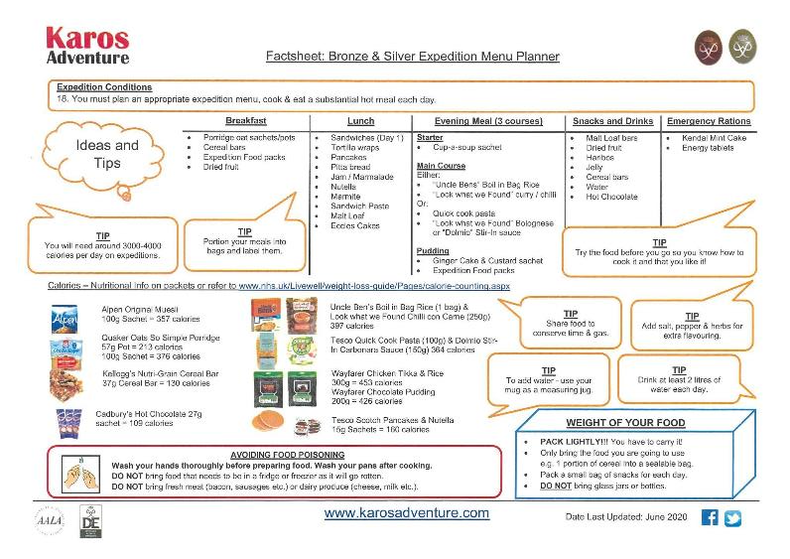
Food & Menu Planning

Slide 27
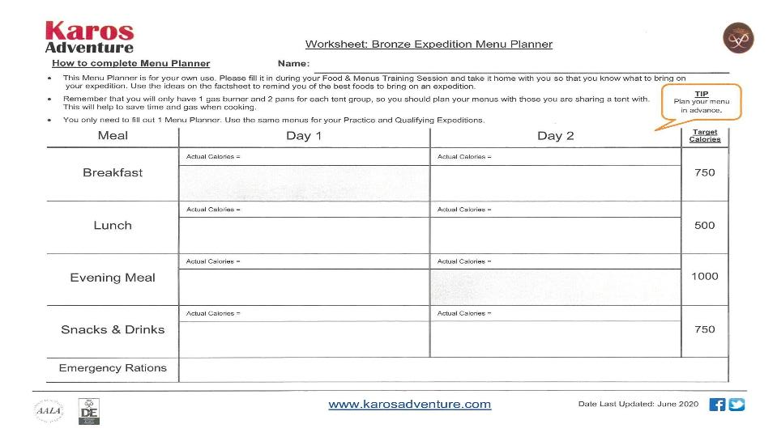
Food & Menu Planning

Slide 28
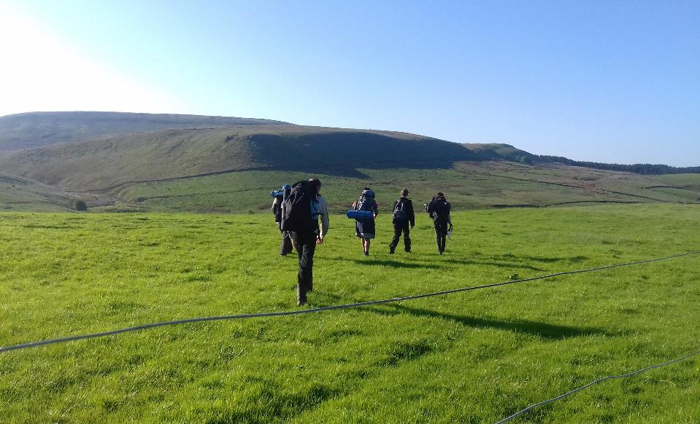
Key Dates & Locations

Slide 29
Key Dates - Bronze
Residential Training (2 days with overnight camp)
Sat 17th – Sun 18th June 2023
Beaumanor Hall, Woodhouse, Leicestershire
Qualifying Expedition (2 days & overnight camp)
Sat 1st – Sun 2nd July 2023
Cannock Chase

Slide 30
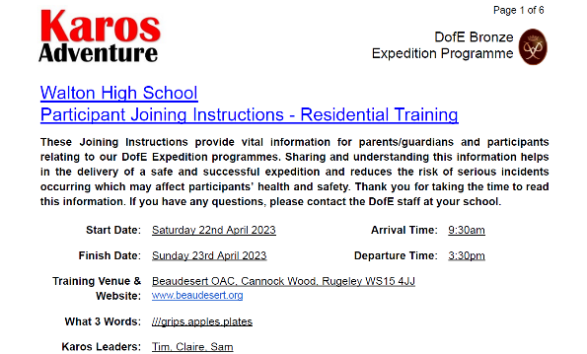
Joining Instructions
Issued around 3-4 weeks before each activity.
Dates, time, venue, start & finish points, staff.
Critical information - please take time to read.

Slide 31
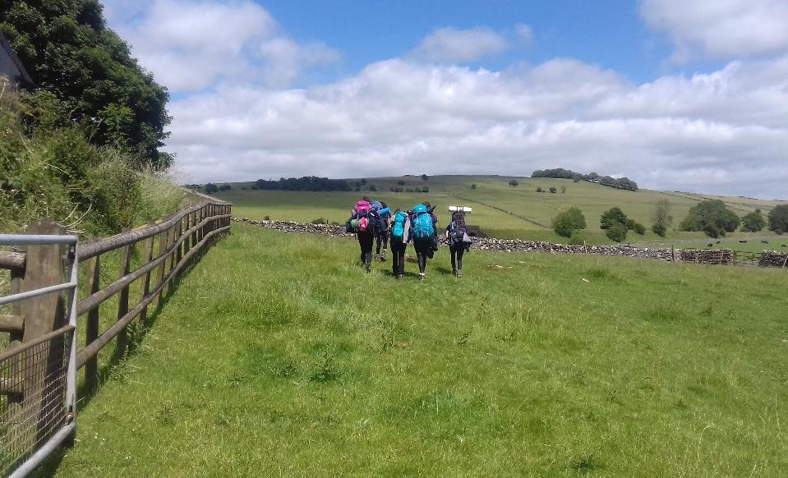
Summary

Slide 32
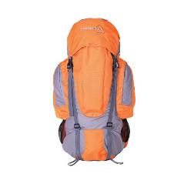
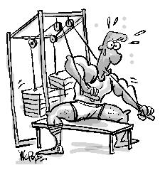
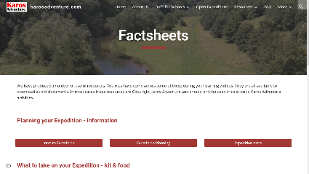
Getting Ready
Think about what kit & clothing you need
Do some exercise - walk the dog, swim, gym
Download our factsheets & training videos

Slide 33

Thank you for listening.
Please feel free to ask any questions.

Slide 34

DofE Presentation Evening
6pm Wednesday 19th July 2023
If a student has been unable to complete all
sections they are very welcome to come and
share in the evening celebrations. Students
have until they are 25 to complete the award.
Notes:
Presenter: Please customise this slide with the contact details of your DofE leader/administrator.
​Outline the next steps for parents:​
​Check the school / organisation’s process for signing up to DofE.​
​Parents / carers will need to complete and return some paperwork and payment.​
​Start a conversation with your young person about what activities they might choose for their DofE.​

